Slide 1


2025 Subordinated Debt Issuance
R5 BILLION UNSECURED SUBORDINATED CALLABLE NOTE PROGRAMME
Presented by: Wikus Olivier and Charisse Ras
September 2025
Santam is an authorised financial services provider (FSP 3416), a licensed non-life insurer and controlling company for its group companies.

Slide 2
Contents
Overview
Santam Business Portfolio
Operating Environment
Strategic Update
Financial Results
Capital Management
Risk Management
Debt Capital Market Offering

Slide 3

Overview
Santam is an authorised financial services provider (FSP 3416), a licensed non-life insurer and controlling company for its group companies.

Slide 4
Santam Subordinated Debt Issuance: Summary
Background
Santam has received in-principle approval from the Lloyd’s council to set up a Santam Syndicate, with a planned gross written premium of approximately £300 - 400 million for 2026.
Lloyd’s syndicate capital requirement (LSM) will be funded through surplus capital.
The R2bn issuance has been designed to replace the R1bn SNT05 note, which is callable in November 2025, and to support the Santam Group's regulatory capital requirements following growth through the Lloyd’s syndicate – Santam Syndicate 1918.
Performance – 1H25
Conventional insurance GWP growth of 10% (2024: 8%)
Conventional insurance NEP growth of 16% (2024: 7%)
Underwriting margin for conventional insurance business of 11.3% (2024: 6.5%)
Alternative Risk Transfer earnings of R417 million (2024: R326 million)
Net income of R2 045 million
(2024: R1 718 million)
Return on capital of 33.2% (2024: 33.6%)
Risk Management
Significant focus on risk management across all areas of the Santam Group.
Key risk themes include:
Underwriting risk
Reserve risk
Market risk
Credit risk
Operational risk
Legal and regulatory risk
Financial Strength – 1H25
Group economic capital coverage ratio of 170% (Dec 2024: 166%)
Interim dividend of 590 cps (2024: 535 cps), up 10.3%
Financial Leverage
R3.0bn subordinated debt in issue
Regulatory scope to increase this to R4.9bn (50% of SCR)
Aim to maintain debt/equity ratio between 25% - 30% (June 2025: 22.7%)

Slide 5

Santam Business Portfolio
Santam is an authorised financial services provider (FSP 3416), a licensed non-life insurer and controlling company for its group companies.

Slide 6
Santam Business Portfolio
Santam
Client
Solutions
Our digital-first
omni-channel insurance business in South Africa
Santam Direct
Sanlam Tied Agent
Santam franchises
Santam
Broker
Solutions
Our multi – and independent intermediary channels in South Africa and Namibia
Independent intermediaries
Outsourced business
Digital intermediaries
Santam
Partner
Solutions
Our partnership and niche ART solutions business, which also focuses on generating new alternative revenue streams from
Telco partnerships – MTN
Financial services – Sanlam, NMSIS (Multichoice)
Other partnerships to penetrate the uninsured market
Ecosystems and platform services through Kandua
Santam
Specialist
Solutions
Our specialist insurance business portfolio in Africa, India and Southeast Asia
Agriculture
Niche
Pan-African partnership with SanlamAllianz
Santam Re
Our reinsurance business in
South Africa and International markets
MiWay
Our direct insurance business in South Africa
Outbound
Inbound
Commercial tied agents
Value-added products and services
Digital
Santam Syndicate 1918
The set up of the Santam Syndicate 1918 at Lloyd’s will accelerate our international and diversification play through specialty business
Conventional Insurance
ART
Our ART businesses
Centriq insurance Group
Santam Structured Insurance
Alternative Risk Transfer

Slide 7

Operating Environment
Santam is an authorised financial services provider (FSP 3416), a licensed non-life insurer and controlling company for its group companies.

Slide 8
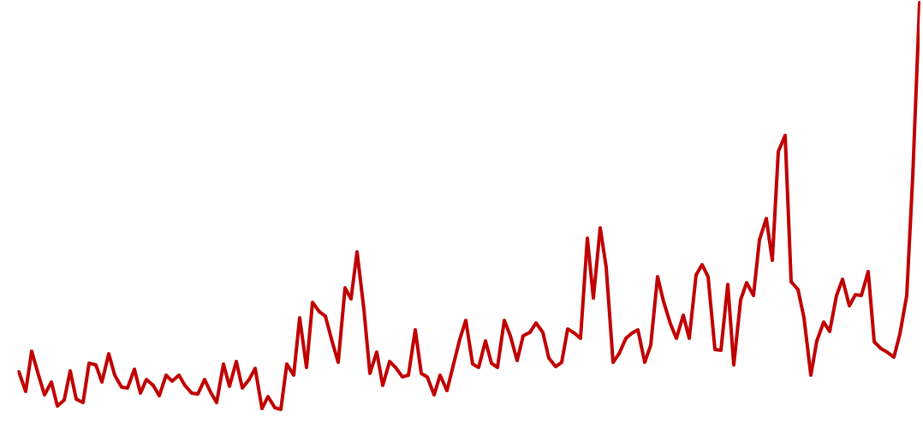
Global growth is facing headwinds, driven by trade policy uncertainty and heightened geopolitical tensions, with P&C rates softening
Global economy faces trade-related headwinds
Global Commercial Pricing environment softening
GLOBAL GDP
GLOBAL GDP
Heightened uncertainty driven by trade war and geopolitical tensions
Global insured losses growing at a long-term rate of 5-7% annually
WORLD UNCERTAINTY INDEX
Earthquakes: Japan & NZ
Wildfires: US
Earthquake: Chile
Q1’90 Q3’93 Q1’97 Q3’00 Q1’04 Q3’07 Q1’11 Q3’14 Q1’18 Q1’21 Q2’25
Source: IMF; Swiss Re Institute, Marsh Global Insurance Index, Ahir, H, N Bloom, and D Furceri (2022), “World Uncertainty Index”, NBER Working Paper

Slide 9





SA economy remains constrained by structural and socioeconomic challenges. The US tariffs are expected to cause further strain
Rising frequency and severity of weather events
Crime and societal issues, including rising cyber attacks
Widespread impacts of deteriorating infrastructure (Municipal infrastructure, road, rail, water)
Economic pressures: Low economic growth in South Africa alongside persistent high unemployment and deteriorating business confidence
Source: Santam Insurance Barometer 2025, SARB

Slide 10

Santam Strategy
Santam is an authorised financial services provider (FSP 3416), a licensed non-life insurer and controlling company for its group companies.

Slide 11


We are executing our strategy, laying a strong foundation for accelerated value creation
Our purpose
To safeguard what is important to our clients
Strategic intent
Leading South African insurer driven by data, with the client at the centre of everything we do
Values
Care
Collaboration
Integrity
Innovation
Client and intermediary experience
Growth vectors:
Strengthen leadership position in South Africa
Drive international expansion and diversification
Scale ecosystems and explore new markets through partnerships
Shift to a multi-channel model
Maintain dominance in Broker
Scale Direct and tied agency
Leverage SanlamAllianz
Specialist capability (via Lloyd’s)
Scale Reinsurance
Ecosystem/platform play
Cross-sell across the Sanlam Group
Partnerships: MTN, MultiChoice
Unlock and develop data capabilities to solidify our competitive advantages
Modernise IT and digital capabilities
Digitise our E2E value chain and customer journey
Leverage data and AI to enhance innovation and underwriting (pricing/risk selection)
Good corporate citizen and drive transformation
Win the war on talent (Talent mobility)
Cost excellence
Build resilient communities and establish leadership in sustainability

Slide 12
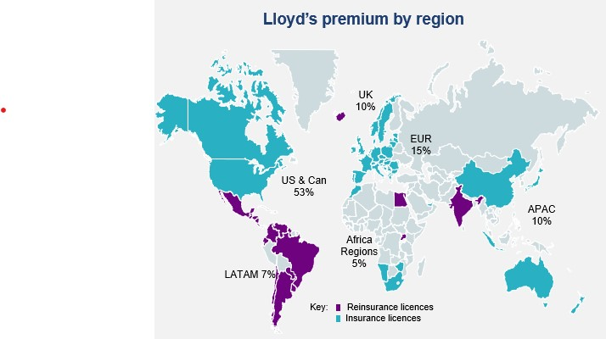
We are accelerating our international strategy through the Santam Syndicate 1918 to transform our growth prospects and investment case
We have received in-principle approval from the Lloyd’s council to set up a Santam Syndicate, with a planned gross written premium of approximately £300 - 400 million for 2026. This will be focused in higher margin specialist business.
Lloyd’s opportunity
Expected impact
Execution through a London-based team
Increase the share of international business to GWP in 2030
>20%
Currently 18%
Cede existing specialist business to the syndicate.
Delivers immediate scale and relevance to the syndicate.
Portfolio mix of 60/40 in 2026, gravitating towards more incremental international over the long term.
Will grow in specialist lines of business that we understand.
Appointing high skilled, experienced team, with strong underwriting and distribution experience
Supported by world-class governance and performance oversight
Partnered with Asta, the leading Managing Agent.
Expected syndicate underwriting margin by 2030
>10%
Return on capital of syndicate in hard currency returns for 2030
>24%
Current hurdle rate
$55 billion GWP – over 7x size of South Africa’s P&C market, ~3x Africa P&C
Access to licenses to trade in 77 insurance and 200 reinsurance territories
Access to Lloyd’s superior ratings with S&P, Fitch and A.M. Best
Strong trusted brand
Strong governance and performance oversight
To be funded through surplus capital
To issue an additional R1 billion in subordinated debt to maintain SA regulatory capital ratios
Ordinary dividend growth philosophy remains
We have also acquired a 51% stake in Avatar Holdings, a new start-up with a unique technology platform that can underwrite and price mid-sized corporate risks much more efficiently than traditional methods. The investment in Avatar amounted to GBP3 million and was funded from available cash resources. Avatar is expected to be a source of future new business for the Santam Syndicate.
Source: Lloyd’s Annual Report 2024; Lloyd’s Capital Market Day Presentation, 12 June 2024; Lloyd’s of London Syndicate analysis June 2025

Slide 13


Our long term targets to 2030
FINANCIAL
GWP GROWTH RATE
NET UNDERWRITING
MARGIN
DIVERSIFICATION
International GWP >20%
Direct GWP> 30%
CPI + GDP + 1% to 2%
5% to 10%
RETURN ON
CAPITAL
DIVIDEND GROWTH
CAPITAL COVERAGE RATIO
>24%
Based on NEP growth
145% to 165%
NON-FINANCIAL
POLICY COUNT
CUSTOMER EXPERIENCE (NPS SCORE)
EMPLOYEE ENGAGEMENT SCORE
>2 million
>60
>75%
MARKET SHARE
TRANSFORMATION
ESG
>24%
Maintain B-BBEE Level 1
Maintain Top 30 JSE Responsible Investment Index

Slide 14

Financial Results
Santam is an authorised financial services provider (FSP 3416), a licensed non-life insurer and controlling company for its group companies.

Slide 15
Results at a glance
16%
11.3%
2.6%
32.7%
56.0%
13.9%
7%
62.3%
31.2%
6.5%
2.3%
8.8%
NEP growth
Claims ratio
Acquisition costs ratio
Underwriting margin
Investment return on insurance funds
Net insurance result
Return on capital
33.2%
33.6%
For the period ended
30 June 2025
For the period ended
30 June 2024

Slide 16

Business Volumes
Santam is an authorised financial services provider (FSP 3416), a licensed non-life insurer and controlling company for its group companies.

Slide 17

Conventional insurance
GROSS WRITTEN PREMIUM VS CPI + GDP GROWTH
Double-digit growth at MiWay, Partner Solutions and Santam Re
First-time contribution of MultiChoice transaction
Good growth at Broker and Client Solutions despite moderation in rate increases
Specialist Solutions impacted by timing differences and soft market conditions in Casualty and Heavy Haulage
Net earned premiums grew by 16%

Slide 18
Conventional insurance
GROSS WRITTEN PREMIUM
GEOGRAPHIC ANALYSIS (%)
Gross written premium remains mostly from South Africa
Positive momentum at Santam Re outside SA
Focus remains on exporting proven capabilities
Launch of Lloyd’s Syndicate to drive accelerated change in profile

Slide 19

Earnings
Santam is an authorised financial services provider (FSP 3416), a licensed non-life insurer and controlling company for its group companies.

Slide 20
Analysis of earnings
R million | Jun-25 | Jun-24 | Variance
Conventional | 2 526 | 2 050 | 23%
Net insurance result | 2 491 | 1 352 | 84%
Investment return on capital | 35 | 698 | (95%)
ART profit before tax | 417 | 326 | 28%
Other | (87) | (60) | (45%)
Associates | 59 | 39 | 51%
Amortisation & other | (146) | (99) | (47%)
Income before tax & non-controlling interest | 2 856 | 2 316 | 23%
Tax & non-controlling interest | (811) | (598) | (36%)
Net income | 2 045 | 1 718 | 19%
Strong growth in net insurance result – improved underwriting performance and return on insurance funds
Investment return on capital impacted by unrealised foreign currency translation differences
Strong growth across most of the ART revenue lines
Annualised return on capital of 33.2%, well in excess of the 24% target

Slide 21

Operating Earnings
Santam is an authorised financial services provider (FSP 3416), a licensed non-life insurer and controlling company for its group companies.

Slide 22
Net insurance result: Conventional
 | Jun-25 | % of NEP | Jun-24 | % of NEP | % change
 | R million |  | R million
Gross written premium | 20 944 |  | 19 084 |  | 9.7%
Net earned premium | 17 920 | 100.0% | 15 395 | 100.0% | 16.4%
Claims incurred | 10 029 | 56.0% | 9 595 | 62.3% | 4.5%
Acquisition cost | 5 866 | 32.7% | 4 807 | 31.2% | 22.0%
Commission | 2 493 | 13.9% | 1 997 | 12.9% | 24.8%
Management expenses | 3 373 | 18.8% | 2 810 | 18.3% | 20.0%
Underwriting result | 2 025 | 11.3% | 993 | 6.5% | 103.9%
Investment return on insurance funds | 466 | 2.6% | 359 | 2.3% | 29.8%
Net insurance result | 2 491 | 13.9% | 1 352 | 8.8% | 84.2%
Combined ratio |  | 88.7% |  | 93.5%
Improvement in profitability of in-force book
Turnaround in property portfolio
Lack of weather-related catastrophe claims and lower attritional claims experience
Favourable float returns

Slide 23

Conventional insurance
NET INSURANCE RESULT: AS A % OF NET EARNED PREMIUM
Underwriting margin above the 5% - 10% target range
Catastrophe claims and large losses of R705 million in 2024 compared to R144 million in 2025
Current favourable claims experience not sustainable over the long term

Slide 24
Investment Results
Santam is an authorised financial services provider (FSP 3416), a licensed non-life insurer and controlling company for its group companies.

Slide 25
Asset liability matching
GROUP CONSOLIDATED NET ASSETS AT 30 JUNE 2025
Disposal of listed equities to fund MultiChoice transaction and to position capital for launch of Lloyd’s Syndicate
Strategic investments mostly reflect economic interest in SGI and NMSIS

Slide 26
Return on capital
TOTAL COMPREHENSIVE INCOME EXPRESSED AS % OF WEIGHTED AVERAGE SHAREHOLDERS’ FUNDS
Dotted line represents the targeted return on capital of 24%

Slide 27
Capital Management
Santam is an authorised financial services provider (FSP 3416), a licensed non-life insurer and controlling company for its group companies.

Slide 28
Capital Requirements – Short Term Insurance Industry
The Prudential Authority implemented the SAM framework during the second half of 2019
Insurance industry uses the standard formula to calculate its regulatory capital requirements
Solvency capital requirement set at a 1-in-200-year loss level over a 1-year time horizon
Insurers can use their own internal model if approved by the Prudential Authority
The Prudential Authority approved Santam’s partial internal model application during the second half of 2019
Santam’s own underwriting risk calculation is used for regulatory capital requirements
Initial capital add-on of 20% on the benefit of the model approval was granted
During 2021, the Prudential Authority reduced Santam’s regulatory capital add-on from 20% to 10%
During 2022, the Prudential Authority further reduced Santam’s regulatory capital add-on to 0%
Santam’s regulatory internal model capital requirement is R2.9 billion lower than the standard formula capital requirement (~18% improvement in regulatory capital coverage ratio for Santam Ltd)

Slide 29
Santam – Capital Bases
Santam uses two capital bases to guide capital management decisions:
Economic Internal Model (EIM):
Based on own assessment of risk
Determined using own internal model
Regulatory Internal Model (RIM):
Underlying structure based on SAM standard formula
Use economic assessment of “Insurance Risk” otherwise use SAM standard formula
Only applicable to Santam Ltd license, all other licenses use SAM standard formula

Slide 30
Option 1
Capital Management Philosophy
Ensuring policyholder security is the highest priority.
Maximising the return on shareholders’ capital within an appropriate risk appetite framework.
Other considerations include:
Buffer over current regulatory capital requirements
Maintaining Santam’s insurer financial strength credit ratings
Funding business growth
Allow for any corporate actions
Santam targets a Group economic capital coverage ratio band of 145% to 165%.
In addition, the regulatory capital coverage ratio must exceed predefined threshold levels.

Slide 31
Economic Internal Model
Santam Ltd – Model Structure
Economic SCR
Insurance Risk
Market Risk
Credit Risk
Reserve Risk
Operational Risk
Premium
Interest
Assets
Catastrophe
Equity
RI Exposure
Prefs
RI Claims
Currency
Receivables
Spread
Concentration
SEM
NMSIS
Associates
Intangibles

Slide 32
Capital Coverage Ratios
The capital coverage ratios for the Santam Group and Santam Limited license at 30 June 2025
Regulatory capital coverage ratio is higher than Santam Ltd.'s economic capital coverage ratio.
Economic Capital (R’m) | Santam Group | Santam Ltd
Own Funds | 16,711 | 14,784
Solvency Capital Requirements | 9,795 | 8,810
Capital Requirements | 170% | 168%

Slide 33
Dividend Philosophy
Santam declared an interim ordinary dividend of 590 cps, up 10.3% on 2024.
Interim dividend will reduce the economic capital coverage ratio to a level that remains at the upper end of the target band (145% to 165%).
Surplus capital above mid-point allocated to fund growth through Lloyd’s Syndicate.

Slide 34
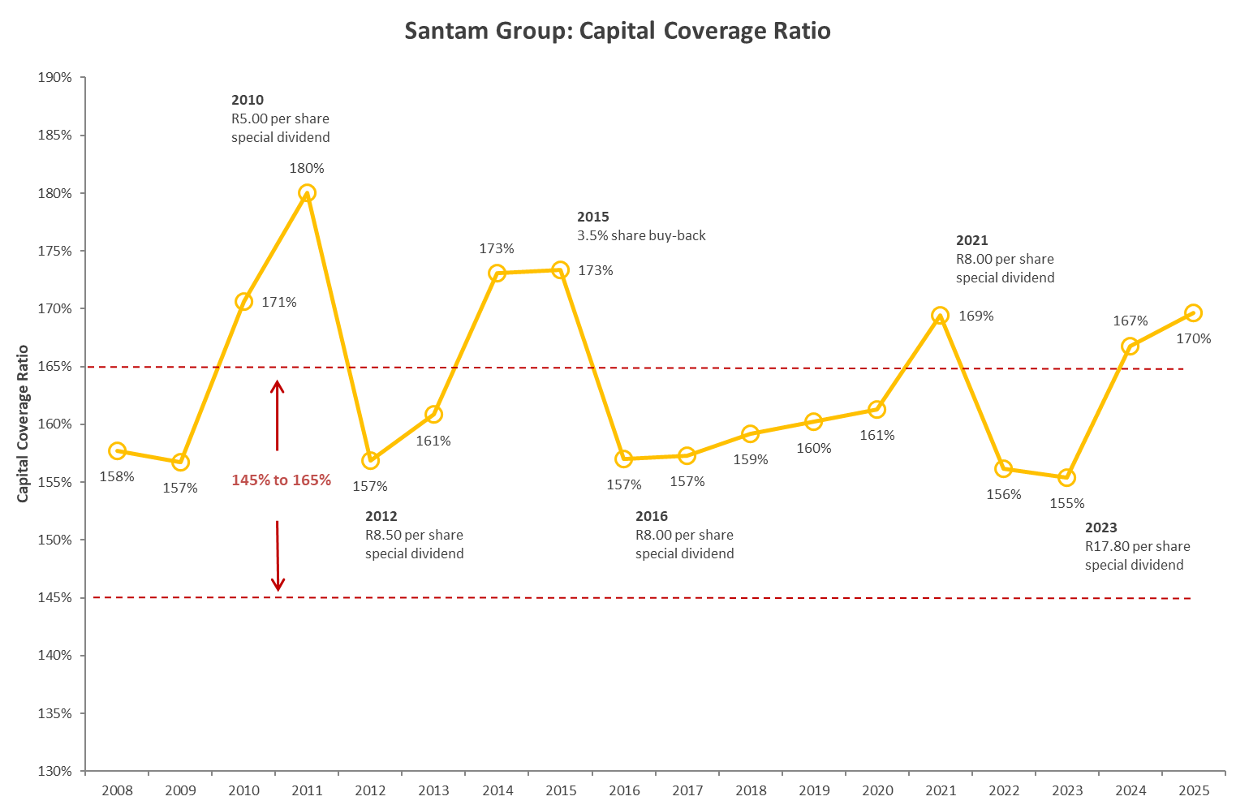
Capital Management History
During 2022, Santam’s target economic coverage ratio band was reduced from “150% to 170%” to “145% to 165%”.
Surplus capital above mid-point allocated to fund growth through Lloyd’s Syndicate.

Slide 35
Capital Structure
The Santam Group capital structure at 30 June 2025:
Additional R1 billion subordinated debt issuance is in support of the Lloyd’s initiative.
 | Capital (R’m) | Capital %
Tier 1: Shareholders Funds | 13,647 | 82%
Tier 2: Subordinated Debt | 3,064 | 18%
Capital Resources | 16,711 | 100%

Slide 36
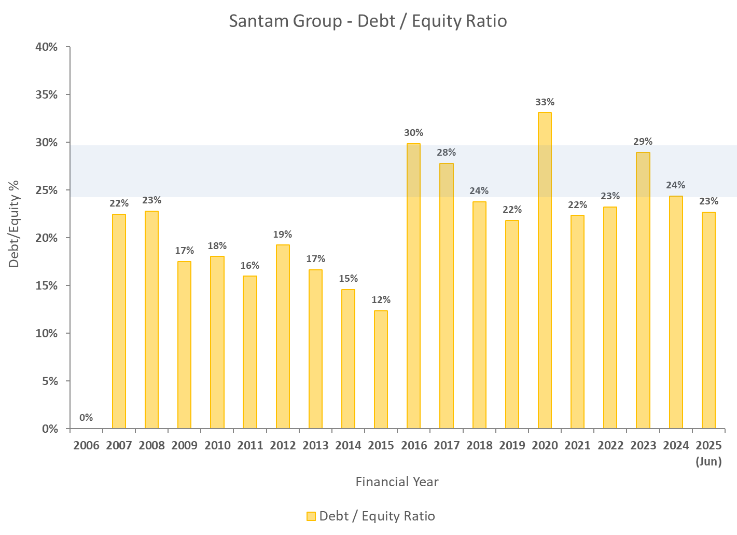
Financial Leverage
R3.0bn subordinated debt in issue.
Regulatory scope to increase this to R4.9bn (50% of SCR).
Aim to maintain debt/equity ratio between 25% - 30%.

Slide 37

Risk Management
Santam is an authorised financial services provider (FSP 3416), a licensed non-life insurer and controlling company for its group companies.

Slide 38
Key Risk Themes
Underwriting risk
R100m per risk; R1.0bn per event
Comprehensive reinsurance program
Diversification – classes of business; geography
Credit risk
Reinsurance and asset counterparties
Minimum international credit rating of A- for reinsurance counterparties
Risk appetite limits on asset and RI concentrations
Reserve risk
Short tail
Monitor actual vs. expected runoff
Track margins in provisions
Operational risk
Mature ERM framework and extensive controls
No significant loss events
Owned by the business
Market risk
Asset mix
Currency exposure
Liquidity of shareholder’s funds
Target debt/equity ratio
No speculative use of derivatives
Legal and Regulatory risk
Strong relationship with both the PA and FSCA

Slide 39
Option 1
Reinsurance Program
Extensive per risk and per event reinsurance program
Maximum exposure per risk of R100 million.
Per event catastrophe deductible of R1.0 billion, Santam is building a catastrophe reserve (June 2025: R470m) as a buffer against catastrophe losses greater than R500m.
Purchased R12.3 billion of catastrophe reinsurance cover (greater than a 1-in-250 modelled earthquake loss based on Santam’s exposure).
Strong relationship with global reinsurance market as Santam is the largest purchaser of reinsurance in South Africa.
Risk appetite requires that Santam only deals with reinsurers with an international credit rating of A- or higher.

Slide 40
Option 1
Risk Framework
Significant focus on risk management across all areas of the Santam Group.
Risks are quantified and understood with appropriate controls, limits and mitigation actions.
Risk appetite framework is key tool for managing risk:
Covers all risk areas of the business
Risk appetites for all main business units that aggregate into an overall Santam Group risk appetite document
Monitored on a quarterly basis
Strong track record of managing risk in a prudent manner.

Slide 41

Debt Capital Market Offering
Santam is an authorised financial services provider (FSP 3416), a licensed non-life insurer and controlling company for its group companies.

Slide 42
Key Features of the Program
Issuer | Santam Limited
Programme Type | Unsecured Subordinated Callable Note Programme
Programme Size | R5 billion
Deferral of Principal | The Issuer is required to defer payment of principal if a Regulatory Deficiency Redemption Deferral Event has occurred, subject to conditions as prescribed by the Regulator.
Deferral of Interest | If on any Interest Payment Date a Regulatory Deficiency Interest Deferral Event has occurred or would occur, the payment of interest in respect of the Notes otherwise falling due on such date shall be deferred.
Early Redemption or Substitution following Capital Disqualification Event | If confirmed by the Auditors that a Capital Disqualification Event has occurred, the Issuer may at its option (but subject to the prior written consent of the Regulator): Redeem all of the Notes; or Substitute all of the Notes with new notes, or vary the terms of the Notes that it will become or remain Qualifying Tier 2 Securities (subject to approval by noteholders by Extraordinary Resolution)
Redemption for Tax Reasons | Notes may be redeemed at the option of the Issuer (subject to the prior written approval of the Regulator), if as a result of changes in laws or regulations the Issuer would be required to pay additional tax (relating to the Notes) and these additional amounts cannot be reasonably avoided.
Events of Default | Non-payment (other than Deferred Payments) Insolvency

Slide 43
Santam Credit Rating
Santam is currently rated by S&P and A.M. Best.
The subordinated notes for the upcoming issuance has been rated by S&P:
 | S&P
Issuer South Africa National Scale Rating | zaAAA (stable)
Subordinated notes | zaAA-
Current notes in issue:
Instrument | Amount | Call Date | Rating
SNT05 (to be replaced by new note) | R1.0bn | 30 November 2025 | zaAA-
SNT06 | R1.0bn | 17 May 2027 | zaAA-

Slide 44
Indicative Terms
 | DMTN PROGRAMME
Issuer | Santam Limited
Arrangers/ Dealers | Absa Corporate and Investment Bank
DMTN Programme Size | ZAR5bn
 | TERM SHEET
Issuer Rating (National Scale) | zaAAA
Subordinated Notes Rating | zaAA-
Instrument | Unsecured and subordinated
Notes Listing & Settlement | The Interest rate market of the JSE
Instrument Note Rating | zaAA-, the S&P Global pre-sale credit ratings report to be provided
JSE Instrument Code | SNT08 | SNT09
Tenor | 5-years | 7-years
Targeted Issue Size | R2bn
Interest Rate Profile | Floating rate notes
Pricing Benchmark | 3m Jibar (to be set on Auction Date)
Price Guidance | TBD | TBD
Coupon Payment dates | 06 Oct, 06 Jan, 06 Apr, 06 Jul
Trade/ Auction Date | 01 October 2025 (Wednesday)
Settlement/Issue Date | 06 October 2025 (Monday)(T+3)
Maturity Dates | 06 October 2030 | 06 October 2032
Auction Times | 09h00 to 11h00
Auction Methodology | Dutch Auction (Sealed bid without feedback)
PA approval | Approval obtained for the issuance
Use of Proceeds | To replace the R1 billion SNT05 note issued in 2020 and callable in November 2025, and to fund regulatory capital required due to the growth through the Lloyd’s syndicate – Santam Syndicate 1918

Slide 45
Indicative Timeline
Indicative dates | Action
8 September 2025 | Auction announcement
17-19 September 2025 | Investor roadshow
23 September 2025 | Price guidance and draft APSs sent to investors
22 - 26 September 2025 | S&P indicative note rating released
01 October | Auction date
06 October | Settlement date (T+3)
September 2025
Sun | Mon | Tue | Wed | Thu | Fri | Sat
 | 1 | 2 | 3 | 4 | 5 | 6
7 | 8 | 9 | 10 | 11 | 12 | 13
14 | 15 | 16 | 17 | 18 | 19 | 20
21 | 22 | 23 | 24 | 25 | 26 | 27
28 | 29 | 30
October 2025
Sun | Mon | Tue | Wed | Thu | Fri | Sat
 |  |  | 1 | 2 | 3 | 4
5 | 6 | 7 | 8 | 9 | 10 | 11
12 | 13 | 14 | 15 | 16 | 17 | 18
19 | 20 | 21 | 22 | 23 | 24 | 25
26 | 27 | 28 | 29 | 30 | 31
 | Public Holiday
 | Auction announcement – no price guidance
 | Roadshow
 | Term sheet with price guidance / draft APSs released
 | Auction
 | Settlement

Slide 46
Questions?

Slide 47
Thank you

